Slide 1

Team4 Port Scan Report
Team 3 : 100% Certified

Slide 2
Port scan
nmap -sV
┌──(kali㉿kali)-[~]
└─$ nmap -sV 192.168.0.106
Starting Nmap 7.91 ( https://nmap.org ) at 2021-06-24 23:06 EDT
Nmap scan report for 192.168.0.106
Host is up (0.0084s latency).
Not shown: 997 cl
osed ports
PORT STATE SERVICE VERSION
22/tcp open ssh OpenSSH 7.6p1 Ubuntu 4ubuntu0.3 (Ubuntu Linux; protocol 2.0)
111/tcp open rpcbind 2-4 (RPC #100000)
3389/tcp open ms-wbt-server xrdp
Service Info: OS: Linux; CPE: cpe:/o:linux:linux_kernel
Service detection performed. Please report any incorrect results at https://nmap.org/submit/ .
Nmap done: 1 IP address (1 host up) scanned in 17.24 seconds

Slide 3
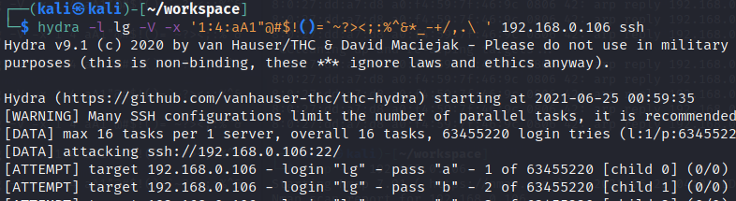
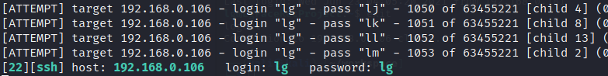
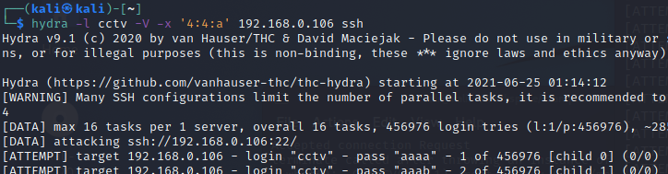
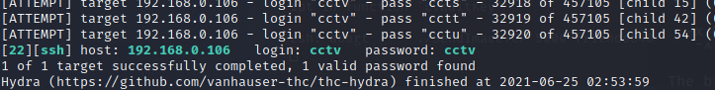
Port 22/tcp ssh
Brute-force SSH login
precondition
knows username
short password length (or default password)
try with username lg (if did not change password - lg)
Got the password in 1053 attempts.
try with username cctv (password is cctv, tried only a lowercase letter)
Got the password in 32920 attempts.

Slide 4
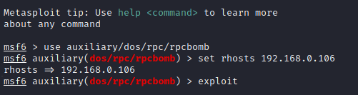
Port 111/tcp rpcbind
libtirpc 1.0.1, 1.0.2-rc and 1.0.2-rc3 has vulnerability ( CVE-2017-8779 )
cause a Denial Of Service
try with mfsconsole / rpcbomb
Failed to make memory consumption with no subsequent free
But while rpcbombing, MonitoringSystem picture displays stopped image.
Version of libtirpc installed is 1.0.10 (PATCHED!)

Slide 5
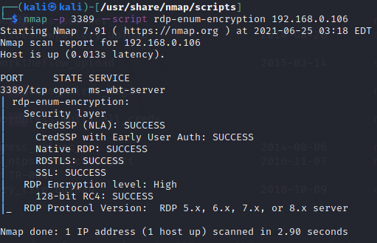
Port 3389/tcp ms-wbt-server
ran nmap script checked but no issues.

